Slide 1
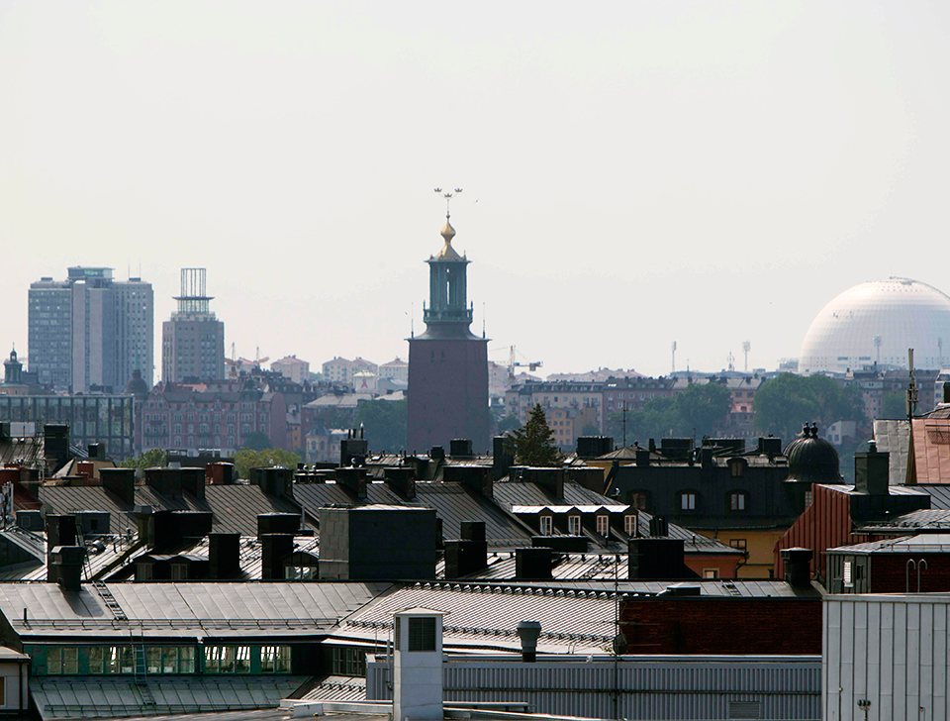
Äldrevänlig stad/age friendly city

Slide 2
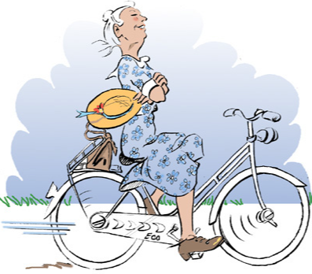
Age- friendly cities is not about elderly care -
it's about how we can build and develop a city that promotes an active and independent life for those who are older

Slide 3

Why age friendly cities?
The proportion of older people is increasing and we are also getting older and older. By 2040, the number of people aged 80 or over will double in Stockholm
At the same time, the number of workers is decreasing
Most elderly people do not have any form of care, only about 19%

Slide 4
WHO:s network age friendly cities and communities
Stockholm became a member of the WHO network 2016
There are 50 countries that are members and over 1000 cities
All Nordic countries have cities that are members and in Sweden there are 6 cities
To become a member, you need to follow the WHO model and start with a baseline measurement and follow up with indicators
The WHO Age-friendly Cities framework developed in the Global Age-friendly Cities Guide proposes eight interconnected domains that can help to identify and address barriers to the well-being and participation of older people.
These domains overlap and interact with each other. For example, respect is reflected in the accessibility of public buildings and spaces and in the range of opportunities that the city offers to older people for social participation, entertainment, volunteering or employment.

Slide 5
Stockholm City Council decided on an action plan in 2021 that follows the WHO model
the action plan contains five areas that need to be developed in order for the city to become more age-friendly. It should be seen as a guide.
The participation and influence of the elderly needs to be part of the development
The importance of cooperating internally and externally and in various partnerships such as academia in order to achieve good results
Reduce social isolation
Develop housing and urban environment towards being more age-friendly
Develop our information and communication to the elderly about what support is available and what is being done

Slide 6
Äldrevänlig stad – encouraging/promoting and prevent development areas för äldre vuxna
Delaktighet och inflytande
Samverkan och partnerskap
Kommunikation och information
Social inkludering
Develop the conditions for participating in activities
Involuntary loneliness and social isolation should be actively counteracted
Mental illness should be actively counteracted
Increase digital skills and participation
Develop meeting points for people with disabilities
Develop working methods to meet elderly people's needs for support and treatment in case of addiction
Violence must be actively combated
Bostäder och stadsmiljö
Urban development
Availability in the property
Being able to move or switch to an accessible home
Affordable housing
Homelessness
Increased safety and security
Climate-smart and resilient city
Promoting mobility opportunities
Gender perspective
Discrimination perspective – ålderism
Disability perspective
Notes:
Handlingsplanen har 5 utvecklingsområden

Slide 7
Steering group
consisting of the City planning and City Development department, sport department, cultural department, and 4 City District, Departments Elderly Services Department and 2 municipal housing companies etc.
Six selected areas to increase skills and work innovatively
Elderly-friendly housing with reasonable rent
Senior housing/collective housing in cooperation with enterprises and academia
Elderly friendly urban environment - nature reserve/areas
Accessibility adaptation labelling of housing
Welfare technology for persons or relatives living at home
Development of the opportunity to practice sport and experience culture for the elderly
Notes:
We do a lot of work when it comes to accessibility in the city's design and to delimit a little we chosen natural areas

Slide 8

The home is increasingly important for health with increasing age...
Older people over the age of 70 spend 80% in their home or in the local area
A home or the immediate area can either be exclusive or inclusive.

Slide 9
Fakta: Ofrivillig ensamhet/social inkludering
3% experience loneliness on a daily basis
2% of nearly 3,000 people and about 250 people in a neighborhood with 12,000 people over the age of 65 want help to break perceived loneliness
Källa: Äldrecentrum
May be as harmful as smoking or obesity
The body may suffer from chronic stress
Has more difficulty dealing with bacteria and viruses and becomes more sensitive to pain
Increases the risk of cardiovascular disease, dementia, depression and depression
Social exclusion activates the same parts of the brain as physical pain.
Different definitions of loneliness
Social loneliness – lacking ties to friends and acquaintances
Social isolation – making social connections, doesn't always mean experiencing loneliness
Emotional loneliness: lacking a confidant person to confide in depth
Källa: Forskare Lena Dahlberg och Peter Strang KI

Slide 10
What are important values for the elderly that affect physical and mental health
Self-determination and independence
Security – close friends, easy to participate in e.g. activities, close, financial opportunities
Reciprocity – not being a passive recipient
Ageism – not stigmatized, "accessibility, beauty and dignity"
The 4 Pillars of Well-Being
Physical activities
Good eating habits
Social community
Meaningfulness
Change perspective from load to needed
Biological ageing
The musculoskeletal system; brittle bones, stiff joints, fewer muscles
Circulation; heart, blood vessels, tired faster
Breathing system; upper windpipes, lungs, more difficult to breathe
Eyes and vision; glare, more light, poorer colour and night vision
The ear and hearing; reduced, difficult to locate sound
The balance; impaired – impaired vision, fewer muscles, fewer sensory cells in the ear
The skin; more sensitive to heat and cold
Nervous system; info slows down
In the home
Outdoor environment/premises
Competence to take
advantage of
Recidens
Real estate
Notes:
Biological ageing and important values for the elderly are important to include in the development work. Many times we develop solely from difficulties in getting around, i.e. our musculoskeletal system
For example, how the home can become more elderly friendly to meet different needs, or the outdoor environment, the property, premises, etc.

Slide 11
Pilotområden:
Development of affordable housing with reasonable rent
Senior housing/collective housing in one or more districts in collaboration with academia and industry
Elderly-friendly urban environment
T-marking of housing/real estate
Welfare technology/data/communication
Development of collaborations that provide increased health (physical, mental and social health)

Slide 12
cooperation with academia
Think together
Technology that enables the elderly to live independently and actively and enables independent living
Products/gods and services that elderly/relatives can acquire themselves
Ask elderly
What do we know about elderlys needs today

