Slide 1
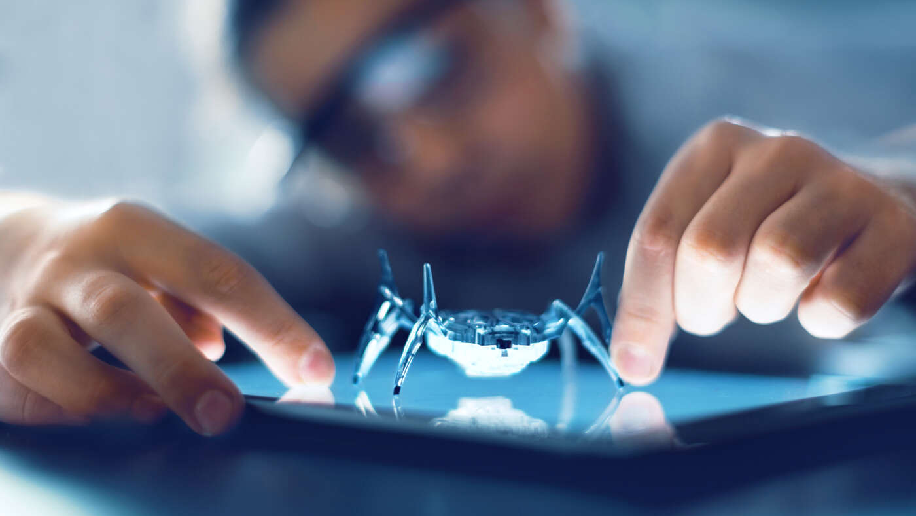
Research on AI/ML for verticals / new-use cases at Ericsson
Maria Edvardsson
Erik Nordell
Sara Thorson

Slide 2
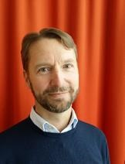
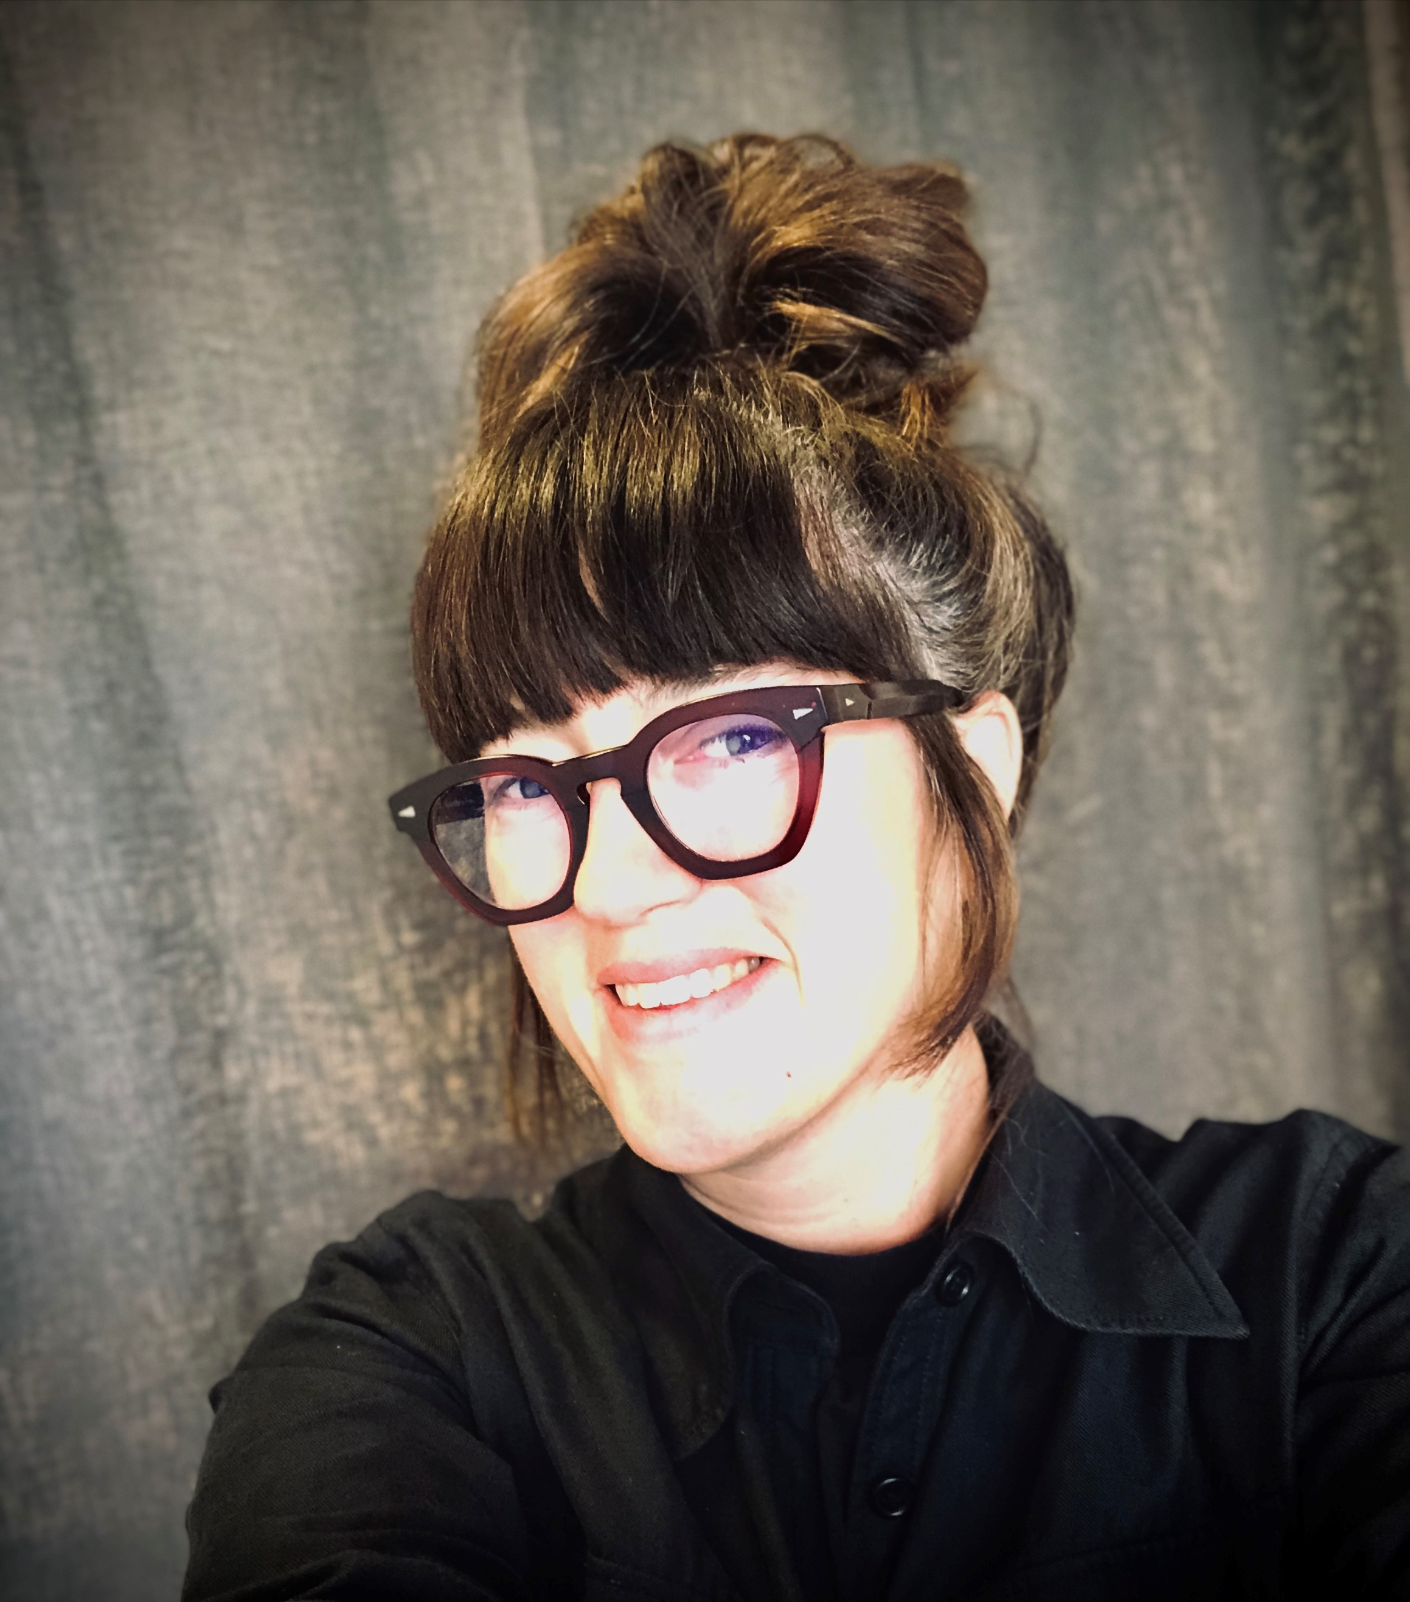
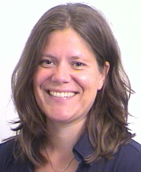
Who are we?
Maria Edvardsson
MSc from EE at KTH 1991-1996. Signal processing and digital communication.
Work at Ericsson Research
  3G-6G so far
  Line manager for last 13 years
  Now program manager for new research program
Erik Nordell
MSc from EE at KTH 1993-1998. Signal processing and digital communication.
At Ericsson since year 2000 mainly in many roles in product development of the Ericsson radio products
At Ericsson Research since 2020 as line manager
Sara Thorson
MSc International Business at Gothenburg University School of Economics 1996-2000.
Ericsson Research Consumer & Industry Lab since 2019
  Use case research
  Consumer & market insight, XR

Slide 3
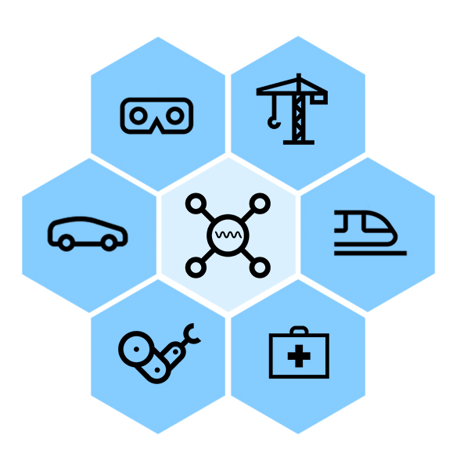
Research program on sustainable digitalization of industries and societies
We engage with ecosystem partners, competitors and universities to gain more knowledge and influence.
We develop solutions that can serve many new use-cases
Technology areas of high interest right now
  eXtended Reality
  Reliable, available and resilient systems
  Sensor integrations, sensor fusion, joint communication of sensing, digital twin.

Slide 4
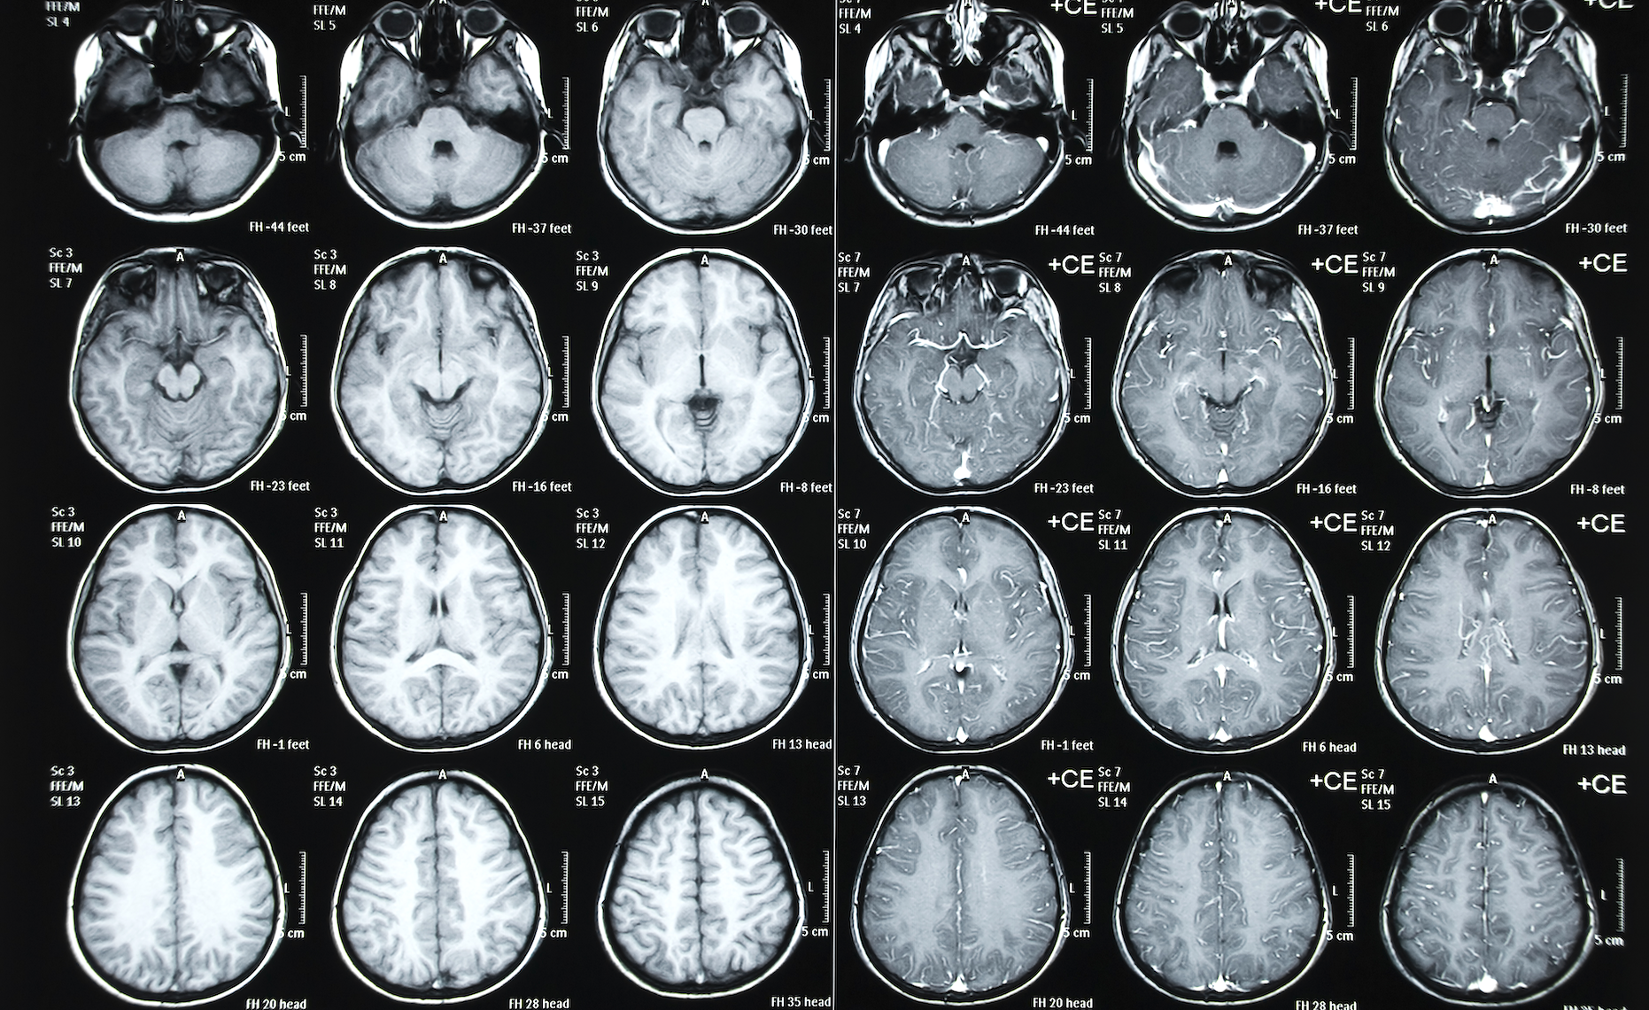
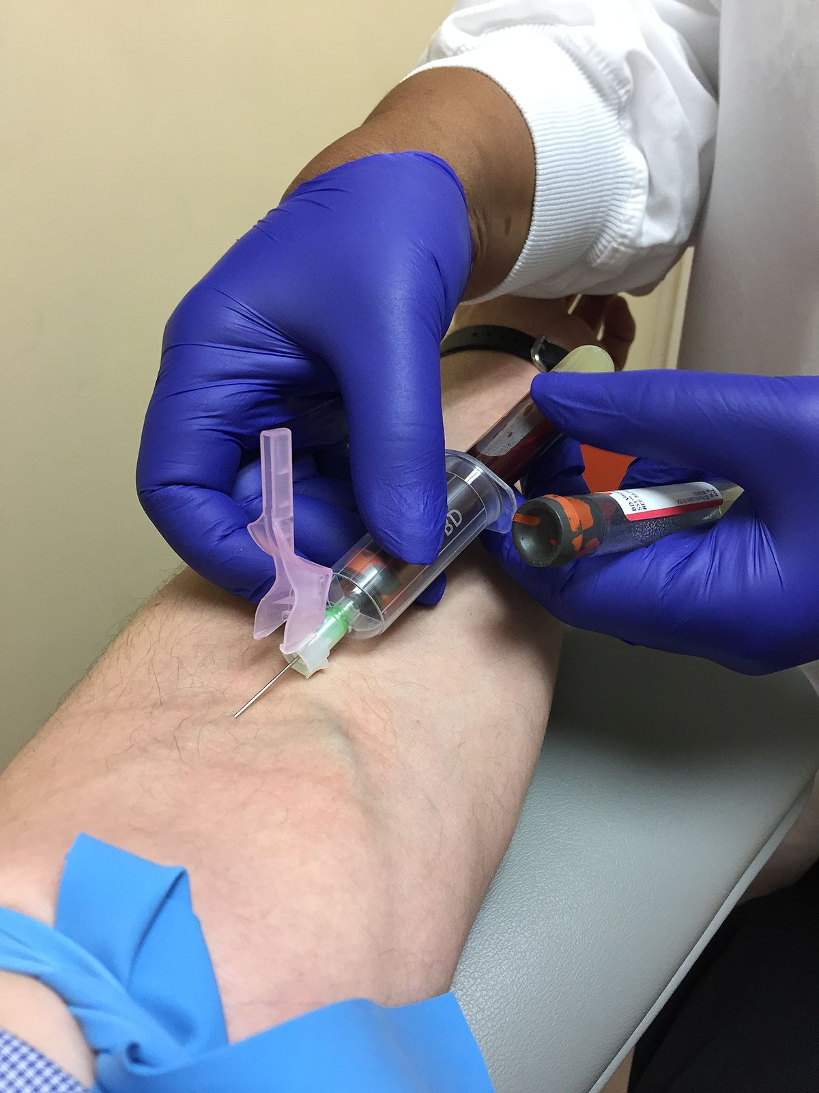
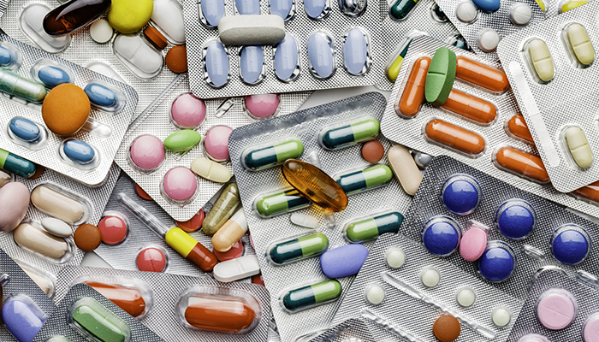
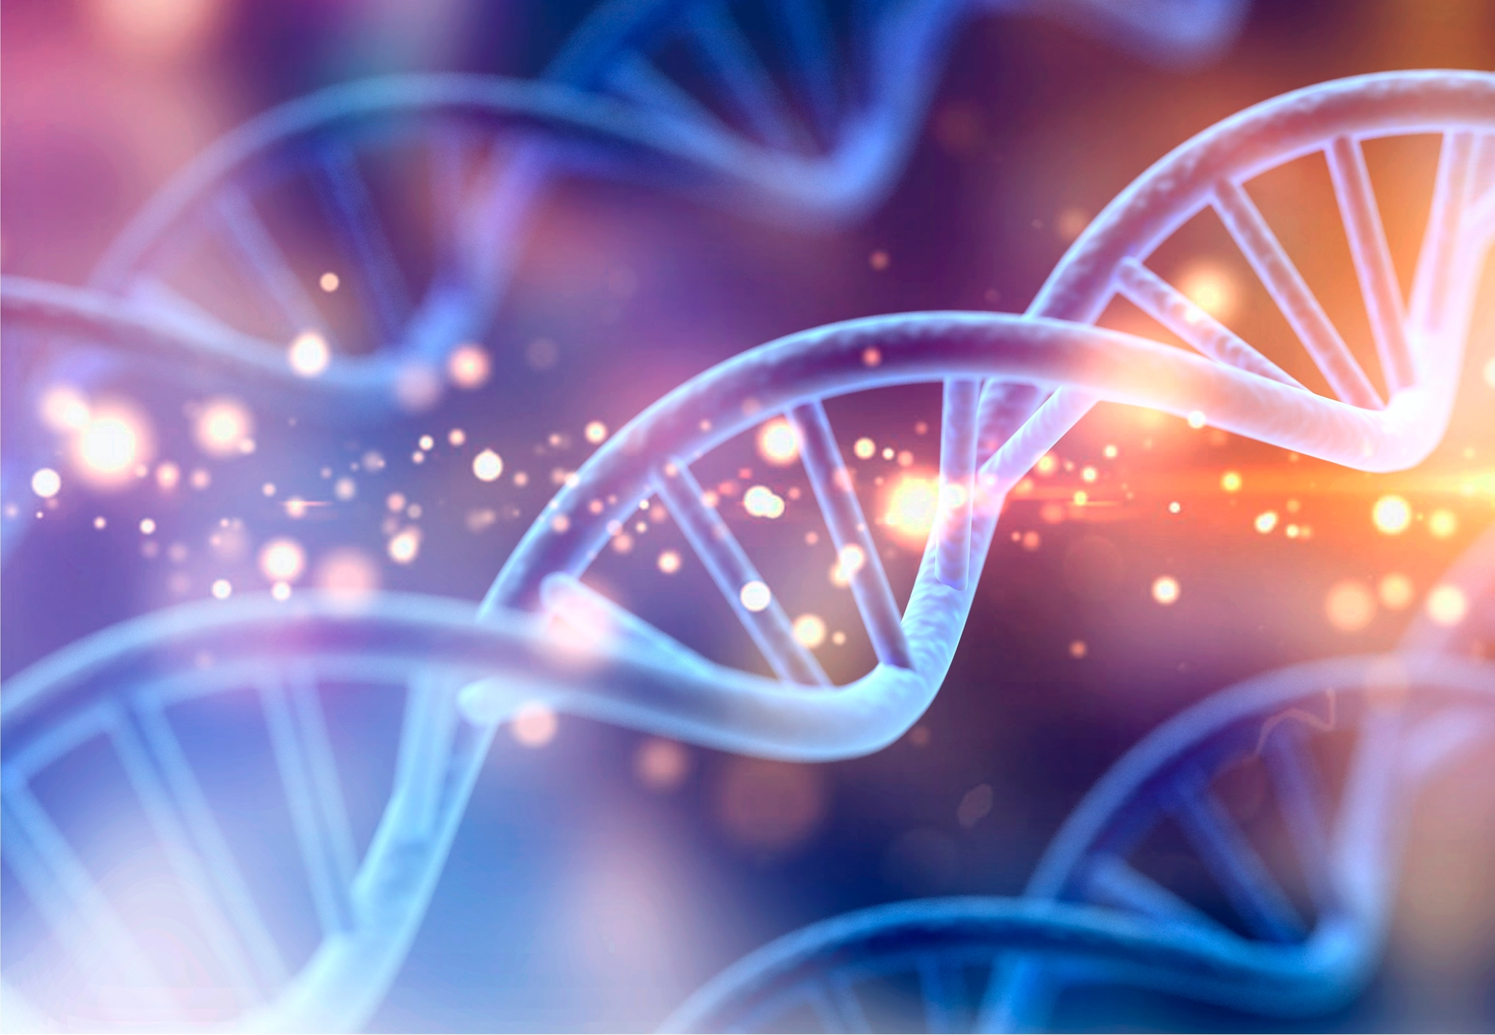
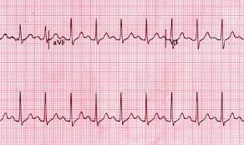
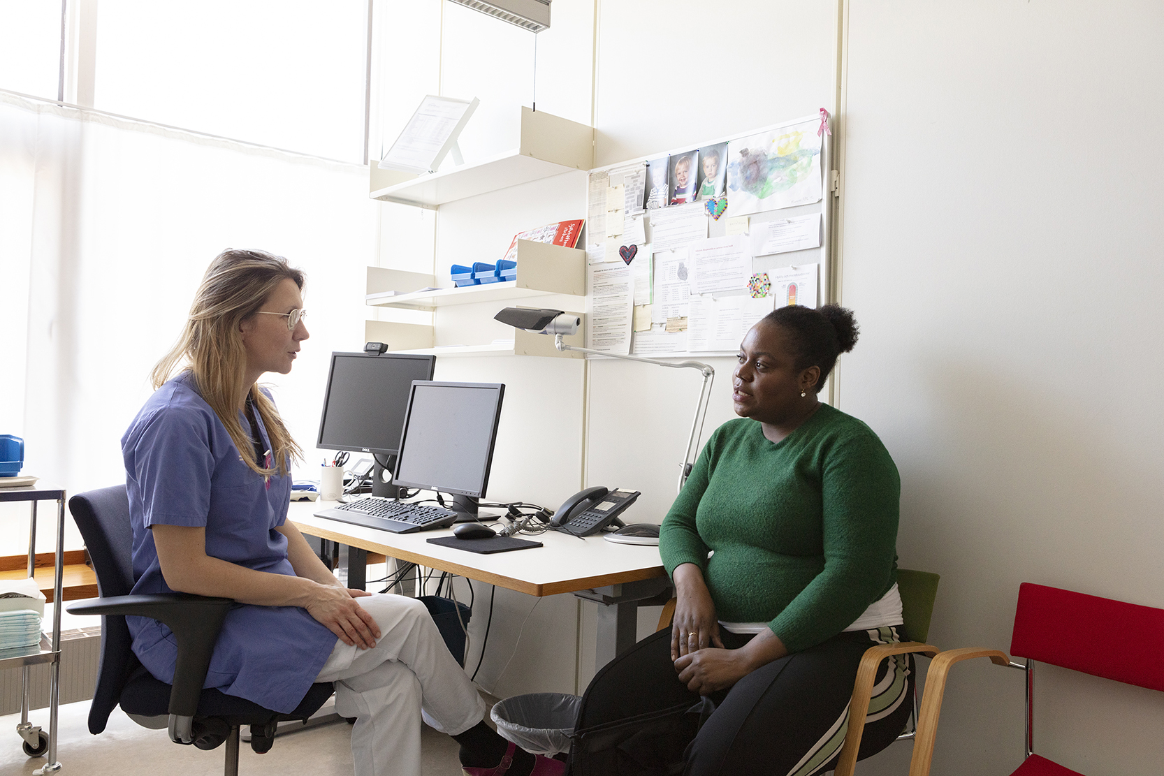
AI in healthcare
To diagnose a patient is to collect data and from that draw conclusions
AI can for example be very useful in finding a diagnose by combining many data sources
AI is good for long time monitoring and finding anomalies etc
Ericsson focus: How can our technology help to drive the health tech industry?

Slide 5
The healthcare use cases in a connectivity view
Indoor systems and dedicated networks in focus
Macro Networks in focus
Hospitals
  Advanced healthcare
  Hi tech
Ambulances, mobile hospitals etc.
Advanced remote healthcare
Health centers etc.
Lower technical demands but still a lot of med-tech equipment
Monitoring of patients and healthy persons anywhere
Wearables
Implants
Connected Healthcare
Nursing homes
Monitoring
Mobile medical equipment
Help systems
Autonomous transportation
Medical devices
Medicine
Blood samples etc.

Slide 6
Stages
Healthy
At Risk
Ill
Remote patient monitoring
Process & workflow automation
Unknowing risk
Knowing risk
XR surgery
Video analytics
Sensing analysis through sensors
Autonomous equipment & mobile Robots
Very little money spent from “government health”
Apple and Google etc plays big role here
Mostly “private money spent
Any type of id,
Under the control of the user (own validated)
Much cheaper treatment if you can go from unknowing risk to knowing risk
Very little money spent here
Room for Innovation
How can health data be used by the hospitals (authentication , security…)
Almost all the money for health is spent here
Identity is social security number (BankID owned by banks)

Slide 7
ML and healthcare
Many things to improve healthcare can be done with today's technology!
Some research areas
  Critical networks – AI for operation and stability
  AI+ XR for e.g. physiotherapy
  Sensors + AI for people monitoring
  Remote experts
  Brain communication
Sustainable digitalization
  What will our society gain by the digitalization of healthcare sector?
  Fulfilment of UNSDGs

